Slide 1
Government Connection: Regulatory Practice and a New Presidential Administration
Two ways to hear the audio:
1. By telephone: Dial: (855) 212-0212
Use Meeting ID: 139-309-818
Through your computer’s speakers/headphones:
-Click the “i” icon in the grey StartMeeting dashboard at the top of your screen
-Download or run the StartMeeting desktop app (make sure your firewall allows)
-Click on the phone icon and select “mic/speakers” and then “connect now”
Maximum capacity is 1,000 participants. If the “meeting room” is full, you will not be able to access it.
Need Help? Contact StartMeeting at 877-553-1680

Slide 2
Government Connection: Regulatory Practice and a New Presidential Administration
Welcome to this Government Connection:
Regulatory Practice and a New Presidential Administration
The presentation is being recorded and will be available on the NAFSA web site at www.nafsa.org/GovernmentConnection
Need Help? Contact StartMeeting at 877-553-1680
Notes:
Steve Springer:
Welcome to this Government Connection: Regulatory Practice and a New Presidential Administration. This is Steve Springer, Director of Regulatory Practice Liaison at NAFSA. Thanks for joining us today.
This is an unusual Government Connection in that we have experts on the law and especially immigration law, rather than government officials, as our presenters. Let me introduce them.

Slide 3
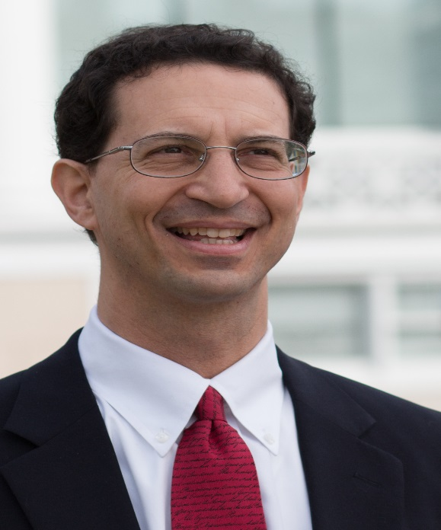
Presenters
Dan Berger
Partner, Curran & Berger, LLP
http://www.curranberger.com
Steve Yale-Loehr
Of Counsel, Miller & Mayer, LLP
http://www.millermayer.com/
Professor, Cornell Law School
Notes:
Steve Springer:
Introduces Dan and Steve Yale-Loehr
Dan Berger Dan Berger is a partner at Curran & Berger, LLP. He is a frequent speaker, editor and writer on immigration law. He won the 1995 American Immigration Lawyers Association (AILA) annual writing competition for an article on Immigration and Naturalization Service (INS) policies toward international adoptions. Berger has also been editor for the AILA Immigration & Nationality Law Handbook since 2000, and edited Immigration Options for Academics and Researchers (2005 and 2011 editions), the International Adoption Sourcebook, and the Diplomatic Visa Guide. He has written on a wide variety of topics, including “Outstanding Professor or Researcher” green cards; temporary visa "D-3 waivers”; green cards for Iraqi and Afghan translators; use of DNA evidence in immigration cases; and the elements of immigration law for in-house legal counsel.
Steve Yale-Loehr Steve Yale-Loehr is an attorney in Miller Mayer, LLP’s immigration practice group. He brings 30 years of immigration law experience to bear in advising corporate and individual clients on a broad array of family- and employment-based immigration matters. Yale-Loehr is an active and internationally renowned member of the immigration law community. He also teaches immigration and asylum law at Cornell Law School as a professor of immigration practice. He also founded and was the original executive director of Invest in the USA (IIUSA), a trade association of EB-5 immigrant investor regional centers. He is the 2001 recipient of AILA’s Elmer Fried Award for excellence in teaching and the 2004 recipient of AILA’s Edith Lowenstein Award for excellence in advancing the practice of immigration law. Yale-Loehr has coauthored or edited a number of books, including Immigration Law and Procedure, the leading 20-volume treatise on U.S. immigration law; Green Card Stories; and America’s Challenge: Domestic Security, Civil Liberties, and National Unity After September 11. He received his juris doctor degree from Cornell Law School and his BA from Cornell University.

Slide 4
Today’s Agenda
Today’s Agenda
Advocacy work ahead
Resources
Q & A
Quick Review: U.S. Legal Authority
Notes:
Steve Springer
After I mention a couple of sort of housekeeping items, I’ll mention some ways you can get involved in advocating for international information, I’ll offer a quick 30,000-foot view sort of review of U.S. legal authority and how we get statutes and regulations, I’ll mention a few resources, and then our experts will address your questions (including the ones you submitted in advance). I know that you want to hear from them, so I promise to be quick.

Slide 5
Submit
Questions
in the
Chatbox
After some introductory information, Dan and Steve will respond to your questions
Remember, they can’t know with certainty what to expect from the new administration
But they are immigration law experts who advise educational institutions and individuals
Notes:
Steve Springer:
Please submit questions via chat box. As I mentioned, most of today’s rather informal program will just be Q&A.

Slide 6
Specific Predictions and Advice
We can’t (sorry)
We can take a deep breath and watch developments closely
Campaigning vs. governing
We will continue doing our work
We will respond to developments
Notes:
Steve Springer:
A few basic ideas to keep in mind today.
It is too early to tell how President-elect Trump’s policies will impact international students who may want to come to the United States.
Campaign rhetoric and actual policy are two very different things. At this point, it is just not possible to know what his new policies will be.
We NAFSAns can continue doing what we do: Advocating for the U.S. to make international education a top priority because the world we now live in requires American students to be able to understand and communicate across cultures, and international students play a key role in enriching our campuses and communities. In addition to the innumerable academic and cultural benefits international students bring, they also contribute more than $32.8 billion and more than 400,000 jobs to our communities.
We will watch developments and respond.

Slide 7
Advocacy
Stay informed:
http://www.nafsa.org/RegInfo
http://www.ConnectingOurWorld.org
Encourage friends, family, and colleagues to sign up for action alerts on Connecting Our World. Share on Facebook, Twitter, and LinkedIn.
Notes:
Steve Springer:
You can keep up with regulatory developments by checking NAFSA’s regulatory information page.
You can also get valuable action alerts from NAFSA through Connecting our World. We have a lot of advocacy work ahead of us. If you have not already signed up for Connecting our World, please do so. It’s a community of individuals raising their voices in support of international education and more globally engaged and welcoming United States. We advocate for policies that foster a more peaceful world, result in a commonsense immigration process, encourage enlightened global engagement, and sustain an informed civic culture through international education. It is, in short, the NAFSA grassroots advocacy vehicle, and it’s a vehicle for you to get involved in advocating for international education.

Slide 8
Advocacy
Help move key legislation at NAFSA's 2017 Advocacy Day. Speak out for students, scholars, and policies that matter to you!
http://www.nafsa.org/AdvocacyDay
Notes:
Steve Springer:
Advocacy Day, March 13-14, 2017 will be an important opportunity for members and advocates to raise their voices, so consider joining us for Advocacy Day.

Slide 9
Statutes and Regulations
Notes:
Steve Springer:
A quick reminder about our legal framework (the oldie but goody hierarchy of authority).
This framework or hierarchy has not changed.
Despite late-night twitter warfare that may indicate otherwise, the Constitution remains unchanged and in effect. It’s the supreme law of the land and sets out the separation of powers in our government: the executive power, the legislative power, and the judicial power. It also provides the means for ensuring that state and federal laws comply with it or are “not constitutional.”
The President can issue executive orders. You know, though, if you followed President Obama’s Deferred Action for Parents of Americans and Lawful Permanent Residents or DAPA executive orders (basically an exercise of prosecutorial discretion that provides temporary relief from deportation and eligibility for work authorization to undocumented parents of U.S. citizens or lawful permanent residents), that these executive orders can be challenged in court and enjoined (or basically killed) by the courts.
You know that Congress makes laws or federal statutes, and that when it makes laws it generally gives agencies the authority to make the regulations necessary to implement such laws. Again, if you followed—for example—DOL’s overtime regulations issued in May 2016, or even the Washtech case challenging the STEM OPT regulations, that regulations can also be subject to a court challenge and delayed or invalidated. It’s important to remember that the process the agencies follow in creating regulations remains unchanged. They are, generally speaking, required to publish regulations (or “rules”) in the Federal Register for public comment. Follow the NAFSA web site and the Advisers Manual news feed to learn about the publication of any new rules, plan to contribute (via IssueNet) to NAFSA’s comment letters, and plan to submit your own comment letter.
Finally, it’s important to remember that the President does not amend the Constitution, make laws, or even create regulations. Granted the President appoints the heads of certain agencies, and they can definitely influence regulations created by the civil servants in the agencies who write regulations. But—again—the President does not write regulations.

Slide 10
Statutes and Regulations
Policy
Regulation
Statute
Constitution
Must conform to
Must conform to
Must conform to
Notes:
Steve Springer:
And it’s probably most important for us to remember how the hierarchy of authority plays out in our day-to-day work. Agency policies must conform to regulations, regulations must conform to statutes, and statutes must conform to the Constitution. New administrations don’t begin with a clean slate, and they face many checks and balances on their powers. Granted they can affect big changes, but there are processes and safeguards along the way. So let’s keep this in mind as we ponder how a new administration might affect our daily regulatory practice.

Slide 11
NAFSA - Agency Engagement
Same
Relationships
People (except at top)
Processes
Different?
Commitment to stakeholder engagement?
Public engagement offices?
Notes:
Steve Springer:
Let’s also remember that NAFSA will continue agency engagement about regulatory practice issues, the area I work in, just as vigorously as we have been pursuing it. We have good professional relationships with our liaison partners—all civil servants—at the agencies, and there’s no reason to expect that these people or our relationships with them will change. The processes for responding to agency initiatives (like new regulations) and for seeking improvements in agency regulations, policies, and processes remain the same (as I mentioned on the last slide). The Obama administration placed a lot of emphasis on public engagement and stakeholder engagement, and many agencies created offices of public engagement to carry out this function. That could change. We don’t know. We’ll just have to continue advocating for this kind of commitment from the Trump administration and wait and see how it goes.

Slide 12
Resources
NAFSA Nov. 18 Virtual Town Hall: “Coming Together, Moving Forward”: http://www.nafsa.org/TownHall
--Recording of the discussion
--List of resources
Steve Yale-Loehr presentation at Cornell (pre-election): “The Presidential Election's Impact on Immigration & International Exchange”
https://www.youtube.com/watch?v=5ZHEqQXxuQw
http://www.cornell.edu/video/borders-ballots-election-impact-on-immigration-international-exchange
Educators for Fair Consideration (E4FC): http://www.e4fc.org/home.html
--”Beyond Deferred Action” Resource http://www.e4fc.org/beyonddeferredaction.html
AILA Quicktake #180: Immigration in the Trump Administration
http://www.aila.org/publications/videos/quicktakes/180-immigration-in-the-trump-administration
American Immigration Law Council: https://www.americanimmigrationcouncil.org/
--Many resources, from “know your rights” to “how the U.S. Immigration System Works”
“Immigration after the Election” (Penn State Law School): https://pennstatelaw.psu.edu/immigration-after-election
American Civil Liberties Union: https://www.aclu.org/
--Extensive “Know Your Rights” library, including immigration-related
Notes:
Steve Springer:
Finally, before Dan and Steve start addressing your questions, let me remind you of some available resources. For now, we are adding all new resources that we identify to the list of resources from the recent NAFSA town hall. So be sure to go to the town hall page, listen to the recording of the town hall and access the ever-expanding list of resources. Let me highlight a few we’ve added in the last few days.

Slide 13
Q & A
Dan Berger
Partner, Curran & Berger, LLP
http://www.curranberger.com
Steve Yale-Loehr
Of Counsel, Miller & Mayer, LLP
http://www.millermayer.com/
Professor, Cornell Law School
Notes:
Steve Springer:
Asks Dan and Steve what about immigration and the new administration are they are watching for or concerned about and how (generally) are they advising clients about this.
David Fosnocht, Director of Regulatory Practice Resources and editor of the Adviser’s Manual will ask Dan and Steve questions submitted by participants through the chat box.

Slide 14
Recordings and Future GovCons
www.nafsa.org/GovernmentConnection

