Slide 1
Media Matters:
Innovations in Study Abroad Promotion
Kay Forsyth, Utah State University
Inger Bull, Nebraska Wesleyan University
Trevor Wright, International Studies Abroad (ISA)

Slide 2
Types of Marketing Featured
DVD
Print (booklet)
Website
Social Networking

Slide 3
DVD Project
Kay Forsyth
Director, Office of Study Abroad
Utah State University

Slide 4
Utah State University (USU)
Logan, Utah
23,000 undergraduate and graduate students
~ 800 international students
7 colleges and more than 200 majors
Named one of “America’s Best Value Colleges” in the Princeton Review

Slide 5
Study Abroad at USU
342 students abroad in 2007-2008
34 partner institutions in 20 countries and access to over 150 universities in nearly 40 countries through ISEP consortia
6 affiliate study abroad providers
15 faculty-led summer and/or short-term programs

Slide 6
USU Study Abroad Marketing Before…..
Flyers on campus
Website promotion
Study abroad fairs
Information sessions
Photo contest

Slide 7
DVD: Initial plan
Planning with media consultants
Students abroad use cameras
Production company edit and compile
Benefits vs. costs

Slide 8
DVD: A new approach
Art department partnership
Graduate student project
University partners abroad
Fleshing out the plan
Creative funding

Slide 9
Determine filming locations and dates
Managing travel between sites
5 countries in Europe
Students onsite for semester or short term programs

Slide 10
Assistance on the ground
Local university partners
Faculty leaders and groups abroad
Study abroad semester students

Slide 11
Implementation
Defining the project--what do we need to know?
    Why Study Abroad?
    Easy
    Benefits
    Affordable
Decide on an itinerary-two weeks filming in Europe
Contact and arrange meetings with universities
Film students on location

Slide 12
Costs of Production
R/T international airfare (grad student)
Local transportation (grad student)
Housing and food (grad student)
Camera equipment donated by Art Dept.
Batteries and film supplies

Slide 13
Production
Follow 2 faculty-led groups in Germany and France
Visit partner institutions in Austria, Netherlands, Germany and Italy
20 hours of footage on locations
Target 5 student “actors”
Branding and logos

Slide 14
Outcomes
Graduate student's first trip to Europe
Graduate student earns 9 credit hours of graduate art credit
Mentoring/grading by art professor
Collaboration on the cutting floor
DVD--conveys the message!

Slide 15
Uses
Classroom presentations
Freshman orientations
Study abroad fair
New student recruiting fairs
Satellite campus study abroad recruiting
Faculty leader workshops
Academic advisor meetings
Postcards to advertise video
Website—home page DVD link

Slide 16
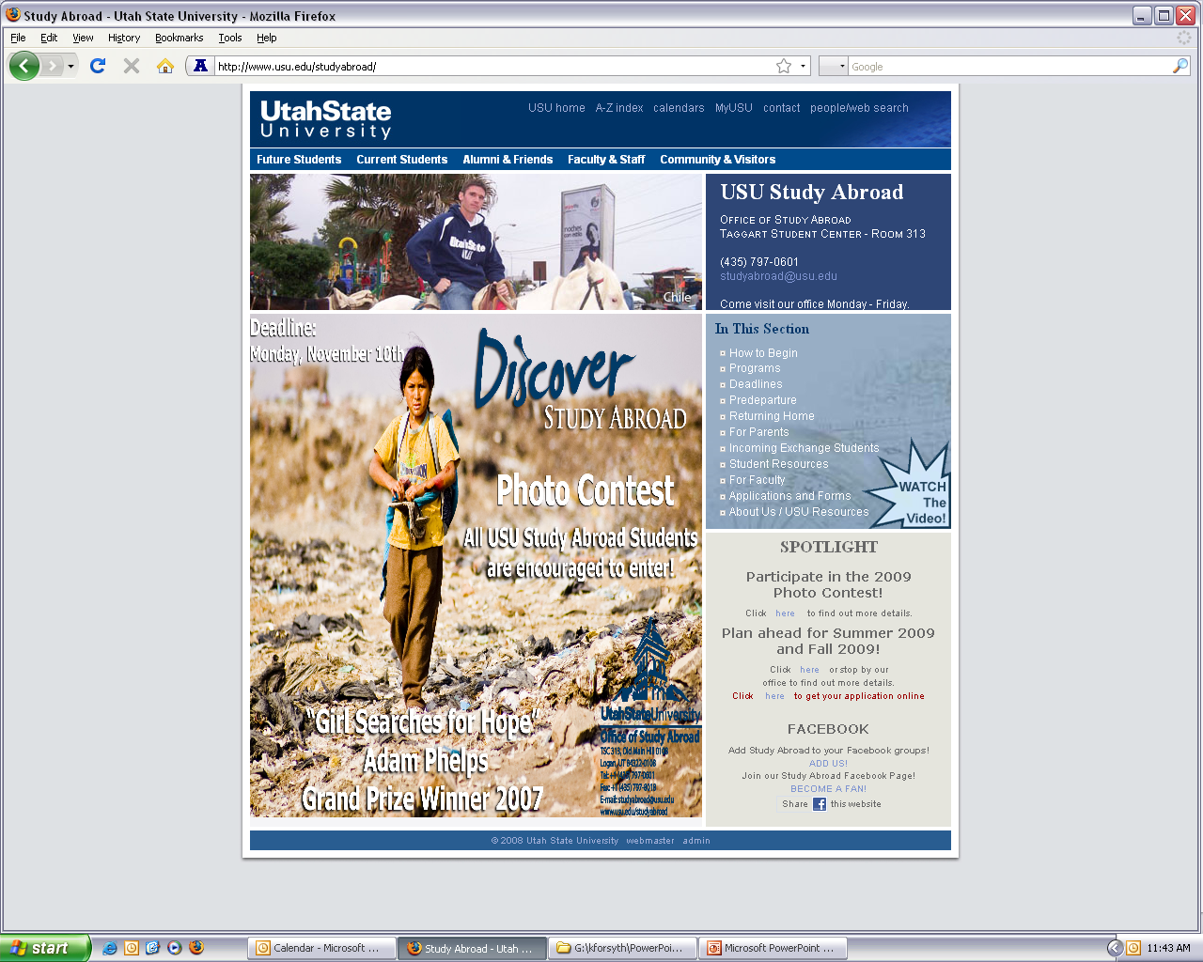
Study Abroad Website

Slide 17
Conclusion
Collaboration across campus/departments
Finished product---great PR!!!
Consistent advertising connections—DVD, postcard logos website advertising, new flyers
DVD launch party— a job well done!

Slide 18
Single Printed Publication
“One Stop Shop”
Inger Bull
Director of International Education
Nebraska Wesleyan University

Slide 19
Nebraska Wesleyan University
Lincoln, Nebraska
1,600 undergraduate students
Small, private, residential liberal arts college
47 majors in five divisions: natural sciences, social sciences, fine arts, humanities, professional
Winner of the 2008 Paul Simon Award for Internationalization

Slide 20
Study Abroad at NWU
~50 students spend a semester or year abroad each academic year
~70 students participate in short-term study abroad each winter and summer
~6-8 faculty-led study abroad programs each winter/summer
34 partner institutions in 20 countries and access to over 150 universities in nearly 40 countries through ISEP consortia
Three bilateral agreements in Estonia, Japan, & Mexico

Slide 21
Print (Booklet)
Who is your audience?
Undergrads vs. grads
Students vs. parents
Faculty?

Slide 22
Professional Printing
Size: Where will they be distributed? Will they be mailed?
Quantity
How many editions per year? One per semester? Summer supplement?

Slide 23
Social Network Sites
Trevor Wright
International Studies Abroad (ISA)
Notes:
Goal is to give you the information, the whats, whys, and hows so you can more effectively reach more students.

Slide 24
What are social network sites?
Web-based sites with services that allow individuals to:
construct a public or semi-public profile within a bounded system,
articulate a list of other users with whom they share a connection, and
view and traverse their list of connections and those made by others within the system.
Notes:
Source: Boyd, d. m., & Ellison, N. B. (2007). Social network sites: Definition, history, and scholarship. Journal of Computer-Mediated Communication, 13(1), article 11. http://jcmc.indiana.edu/vol13/issue1/boyd.ellison.html

Slide 25
Services Available
Instant Messaging (IM)
E-mail
Profile Activity Updates
Privacy Options
Photo & Video Uploading Capability
Interest Groups
Message Boards

Slide 26
Why should we care?

Slide 27

Mr. Millennial

Slide 28

The Millennial Generation
Born between 1980 and 2000
97% own a computer
76% use IM and social networking sites
15% of IM users are logged on 24/7
66.6% of college students have a Facebook profile
Notes:
Junco, Reynol; Mastrodicasa, Jeanna (2007-03-29). Connecting to the Net.Generation: What Higher Education Professionals Need to Know About Today's Students, 1st, NASPA. ISBN 0-931654-48-3. Results from a study of 7,705 college students in the US.

Slide 29
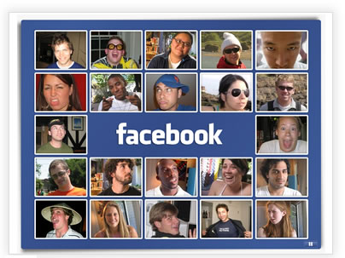

Facebook & MySpace
Making Goofy
Smiles Cool
The “Digital Detroit” of social networks holds onto #2 spot

Slide 30




The Veterans and Up-and-Comers….
Notes:
-

Slide 31
Worldwide Growth among Selected Social Networking Sites
Total Worldwide Audience, Age 15+
 | Total Unique Visitors (000)
 | June-2007 | June-2008 | % Change
Total Internet | 778,310 | 860,514 | 11%
Social Networking | 464,437 | 580,510 | 25%
Facebook | 52,167 | 132,105 | 153%
MySpace | 114,147 | 117,582 | 3%
Hi5 | 28,174 | 56,367 | 100%
Friendster | 24,675 | 37,080 | 50%
Orkut | 24,120 | 34,028 | 41%
Bebo | 18,200 | 24,017 | 32%
Notes:
Source: http://www.comscore.com/press/release.asp?press=2396. Source: comScore World Metrix

Slide 32

How can social network sites help me promote international education?

Slide 33
Promotion / Marketing
Create a Facebook / MySpace profile
Special Interest Groups (e.g. Study Abroad at Utah State)
Link official website to social network sites
Provide social network site info on all written promotional materials
Post program changes & updates
Communicate important deadlines
Disperse scholarship information
Online photo contests
Recruit international students

Slide 34
Effective Connections:
Connect with students before / during / after program
  Sites: Facebook, MySpace
Connect students with students
  Sites: Facebook, MySpace, relevant international site on handout
Connect students with local populations / interest groups
  Sites: Meetup.com, Couchsurfing, Ning.com, relevant international site on handout
Connect students with volunteer opportunities
  Sites: Idealist.org, Nabuur, TakingITGlobal.org
Connect with foreign faculty / universities
  Sites: Linkedin

Slide 35
Continuing Discussion
Privacy issues
Student/Faculty relations
Liability
Effectiveness

Slide 36
To Contact the Presenters
Kay Forsyth, Utah State University
kay.forsyth@usu.edu
Inger Bull, Nebraska Wesleyan University
ibull@nebrwesleyan.edu
Trevor Wright, ISA
twright@studiesabroad.com

